Slide 1
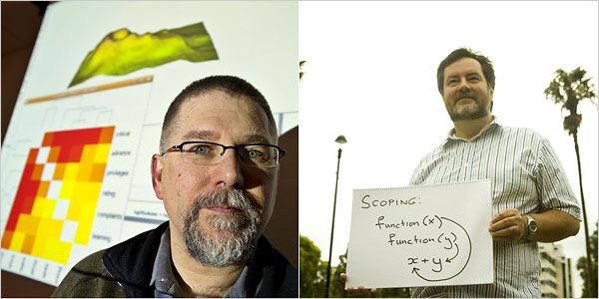
Intro to R
Robert Gentleman
Ross Ihaka
Creators of R

Slide 2
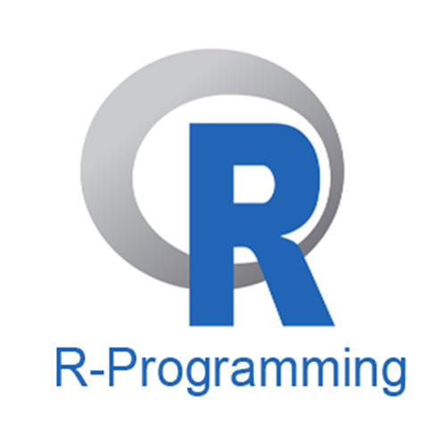
Intro to R
Go to https://cran.r-project.org/ and install version for your operating system
Go to https://www.rstudio.com/products/rstudio/download/ and install R Studio IDE
You need to install R before installing R studio
Alternatives
Install Microsoft R https://mran.microsoft.com/open
Use Microsoft Visual Studio (free version available)

Slide 3
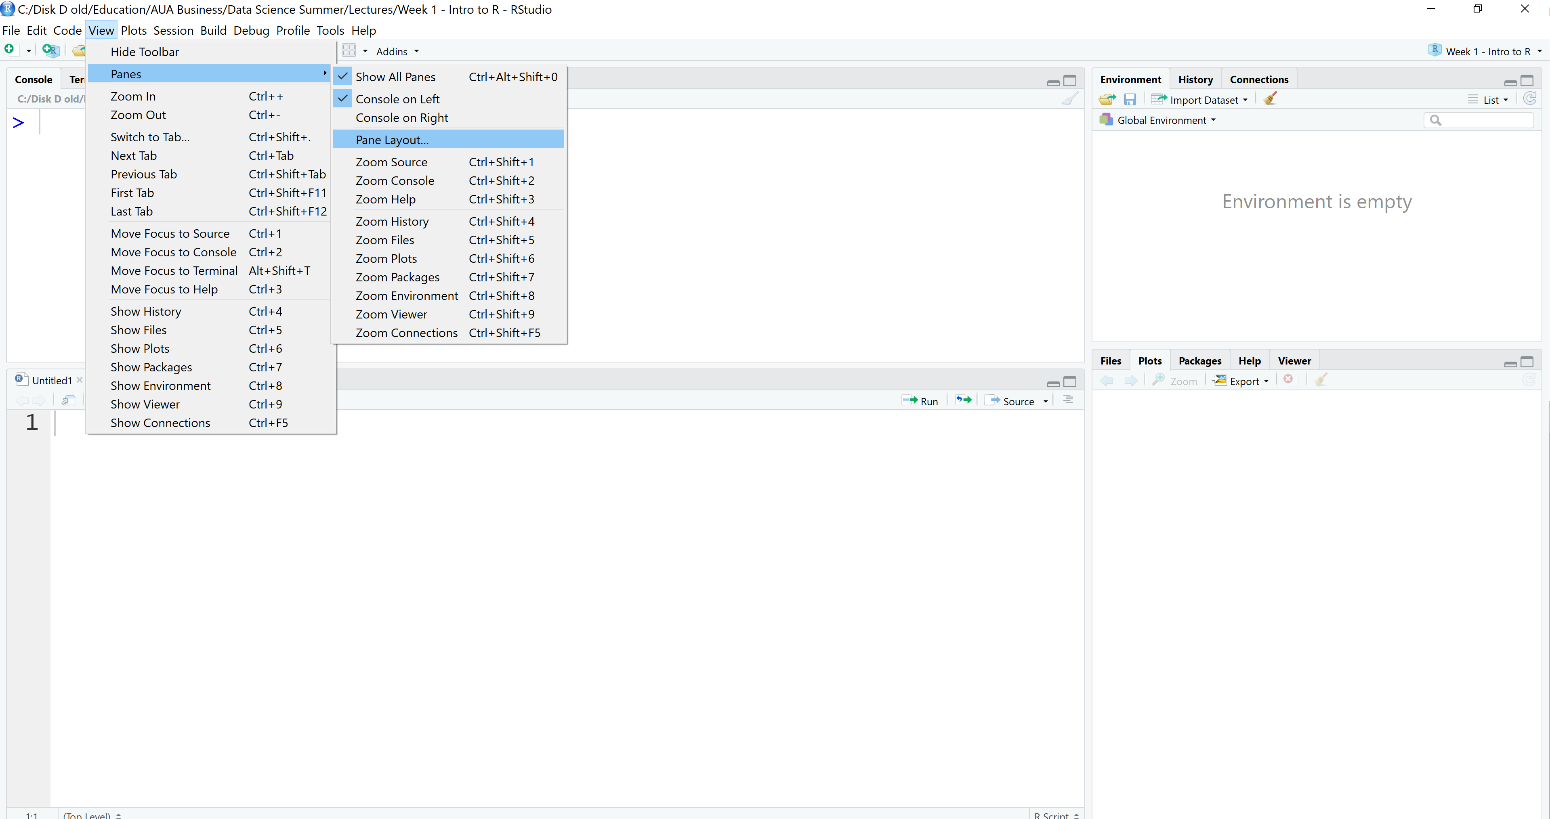
Intro to R
Configure the pane layout of R studio as you wish

Slide 4
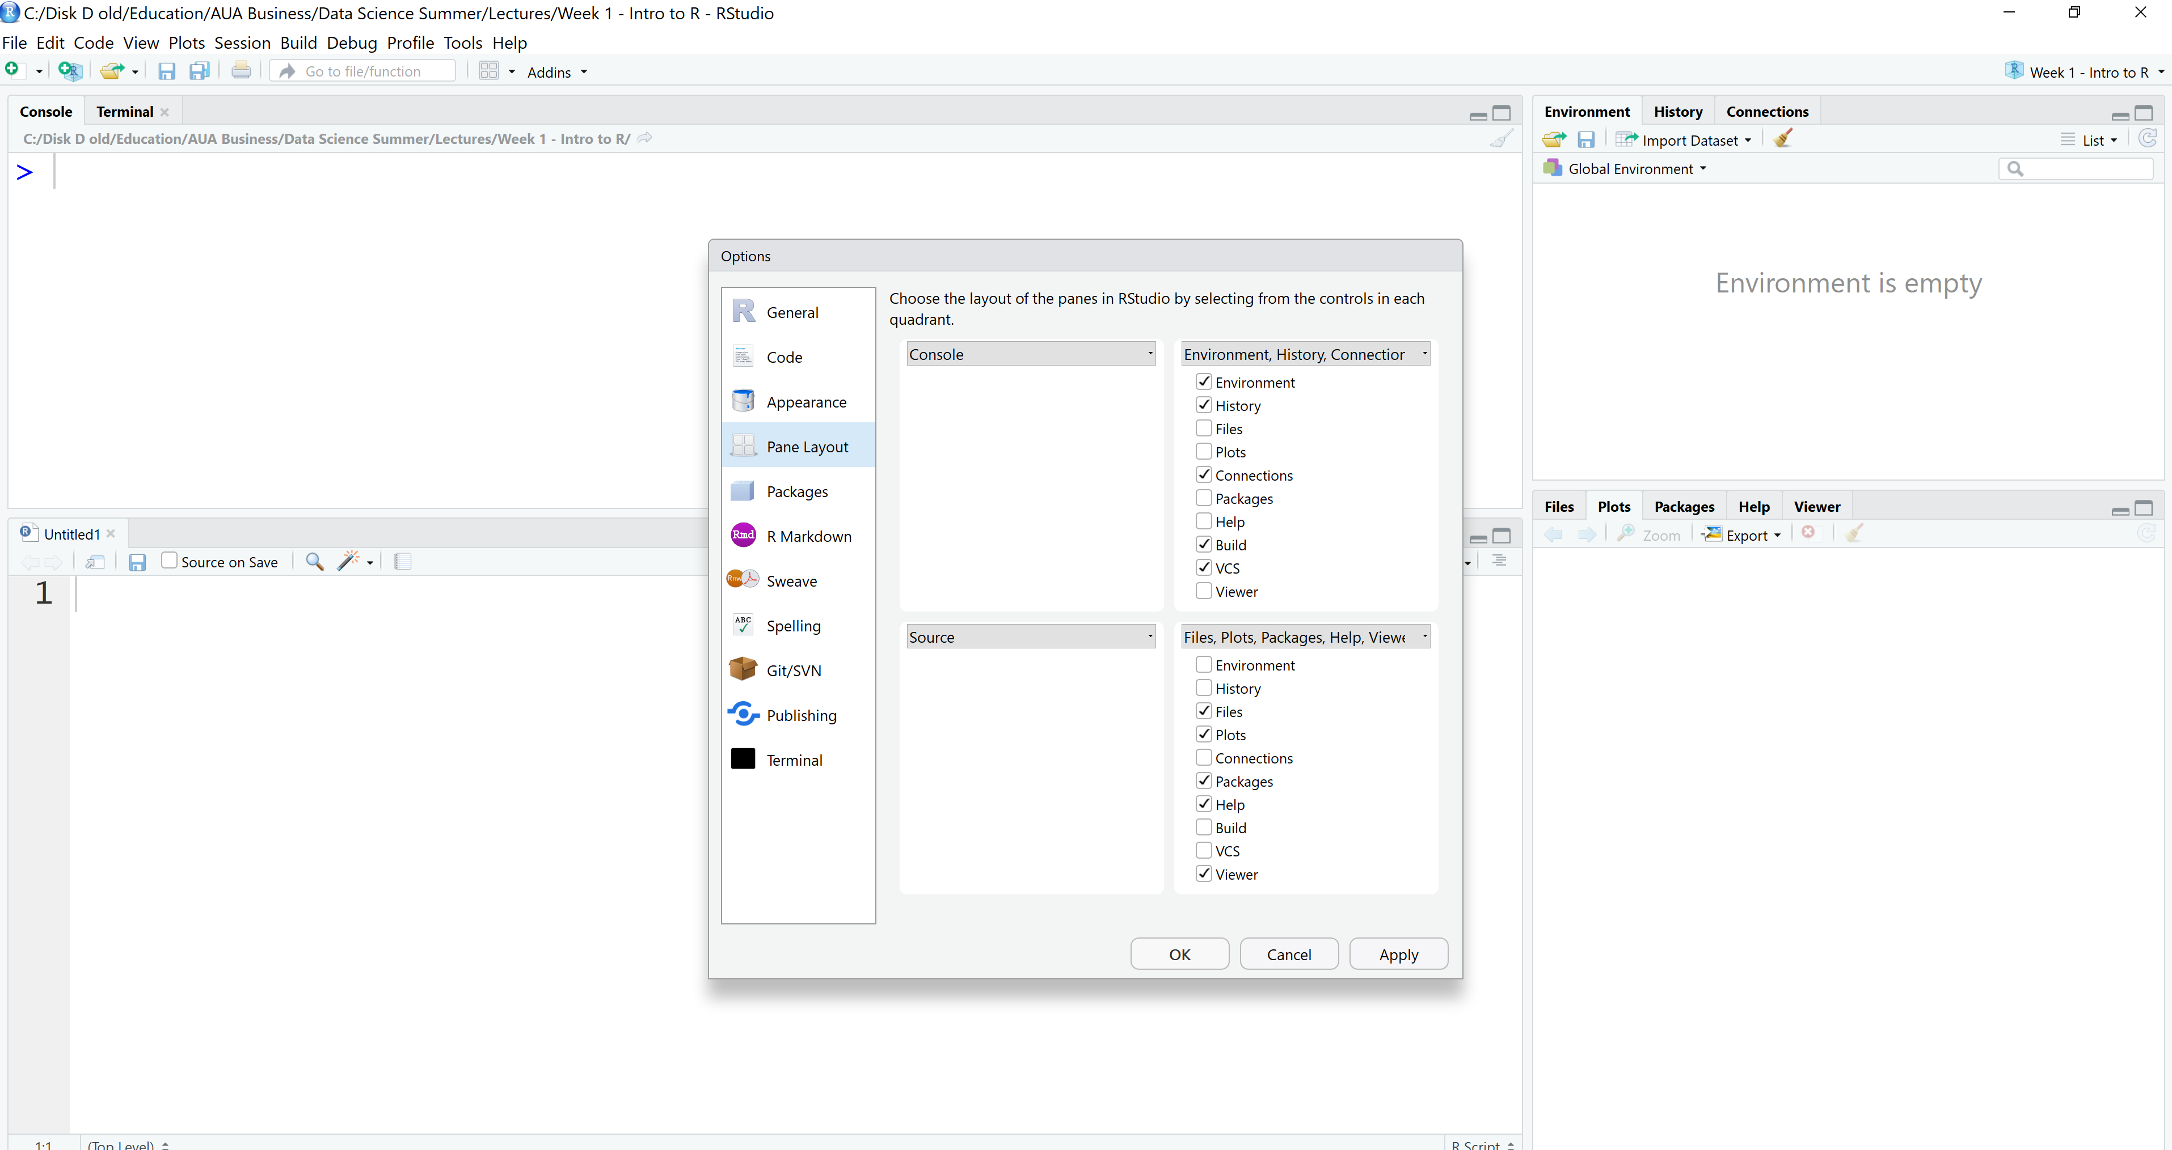
Intro to R

Slide 5
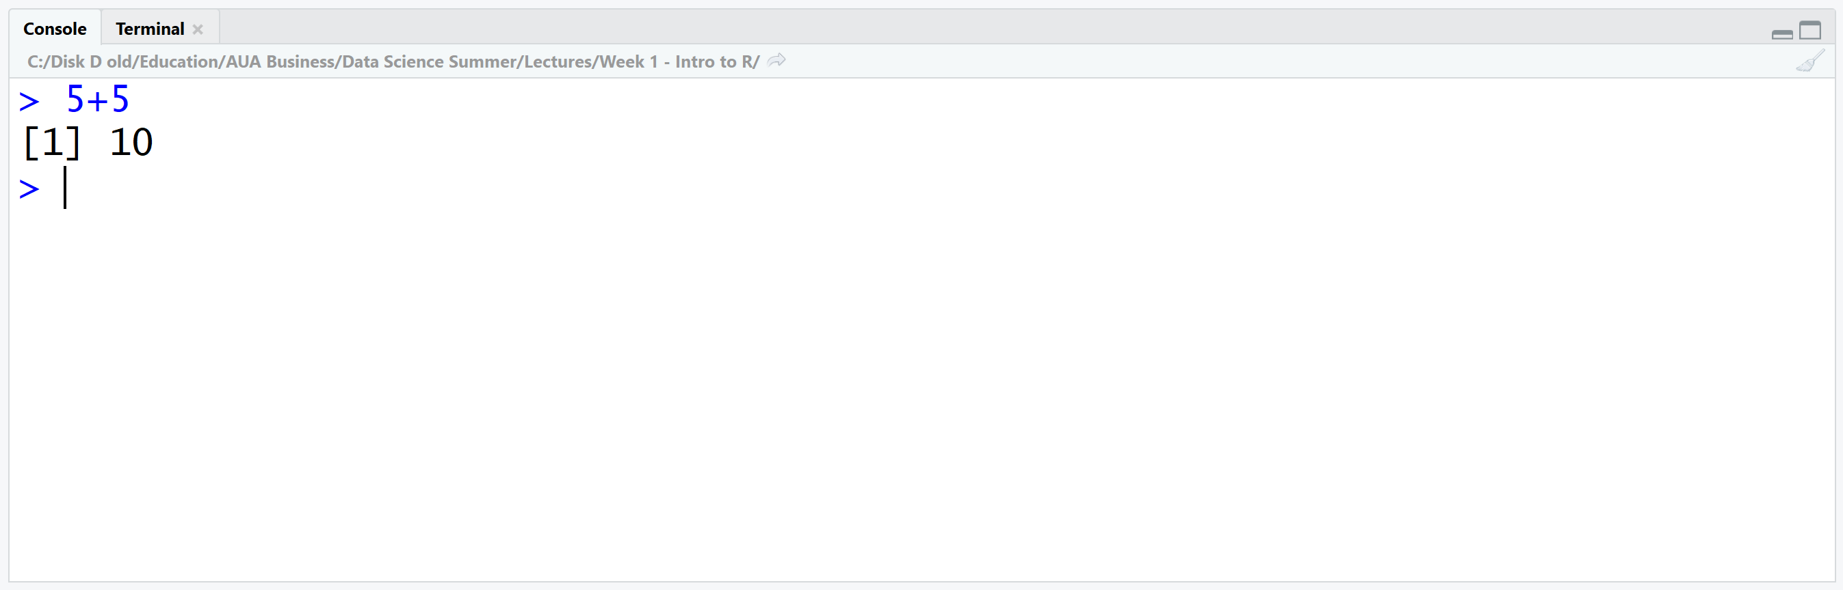
Intro to R: console
Here you can type any valid R command after the > prompt followed by Enter and R will execute that command.
Use console as a calculator
[1] is the index for the output, just ignore it

Slide 6
Intro to R
RStudio projects make it straightforward to divide your work into multiple contexts, each with their own working directory, workspace, history, and source documents.
Creating Projects
RStudio projects are associated with R working directories. You can create an RStudio project:
In a brand new directory
In an existing directory where you already have R code and data
By cloning a version control (Git or Subversion) repository

Slide 7
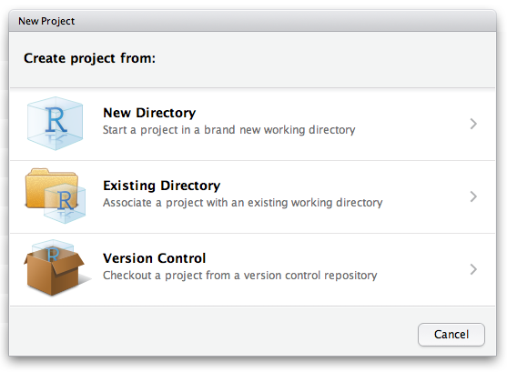
Intro to R
Create an empty directory
Go to File > New Project
Chose existing directory

Slide 8
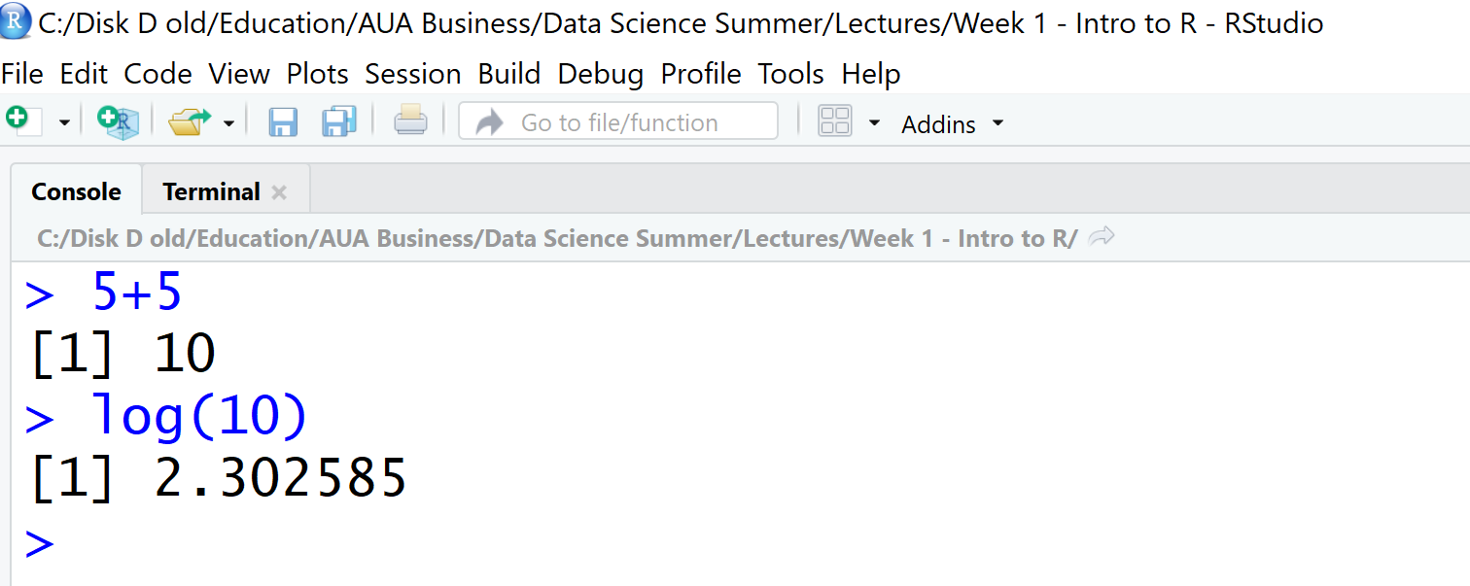
Intro to R
Now when you have created your project, all files associated with the project need to be save in the project directory
To check the project directory do getwd() in console
The name of the project appears at the top of R Studio window

Slide 9
Intro to R
When a new project is created RStudio:
Creates a project file (with an .Rproj extension) within the project directory. This file contains various project options (discussed below) and can also be used as a shortcut for opening the project directly from the filesystem.
Creates a hidden directory (named .Rproj.user) where project-specific temporary files (e.g. auto-saved source documents, window-state, etc.) are stored. This directory is also automatically added to .Rbuildignore, .gitignore, etc. if required.
Loads the project into RStudio and display its name in the Projects toolbar (which is located on the far right side of the main toolbar)

Slide 10
Intro to R
Opening Projects
There are several ways to open a project:
Using the Open Project command (available from both the Projects menu and the Projects toolbar) to browse for and select an existing project file (e.g. MyProject.Rproj).
Selecting a project from the list of most recently opened projects (also available from both the Projects menu and toolbar).
Double-clicking on the project file within the system shell (e.g. Windows Explorer, OSX Finder, etc.).

Slide 11
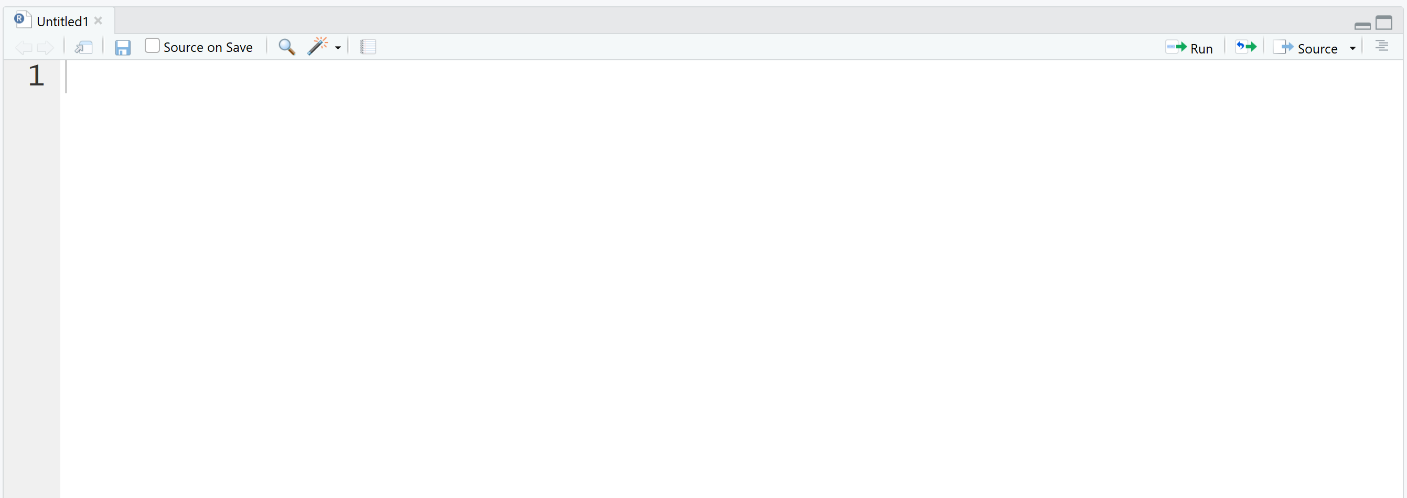
Intro to R
The source editor
If you plan to reuse your code, write it in source editor

Slide 12
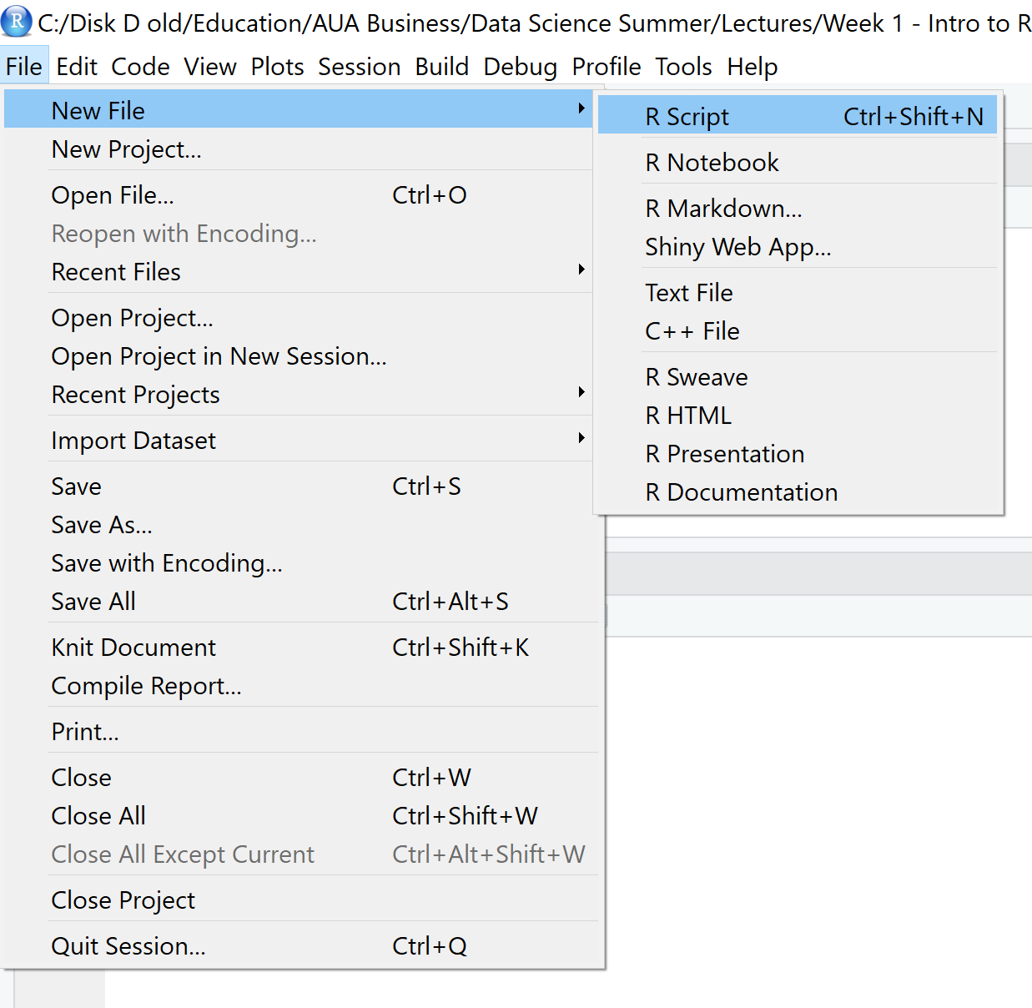
Intro to R
This will create new script file

Slide 13
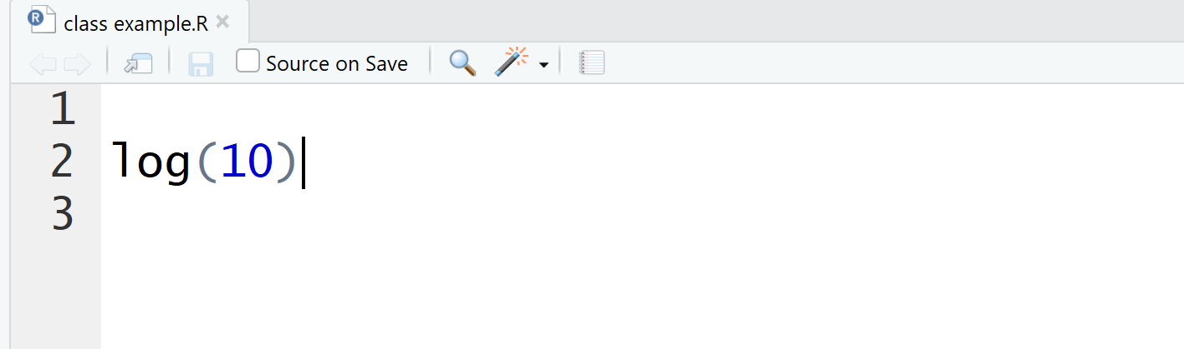
Intro to R
To run the script line from source editor, put the coursor anywhere on the line and hit ctrl+enter
You will see the output in the console

Slide 14
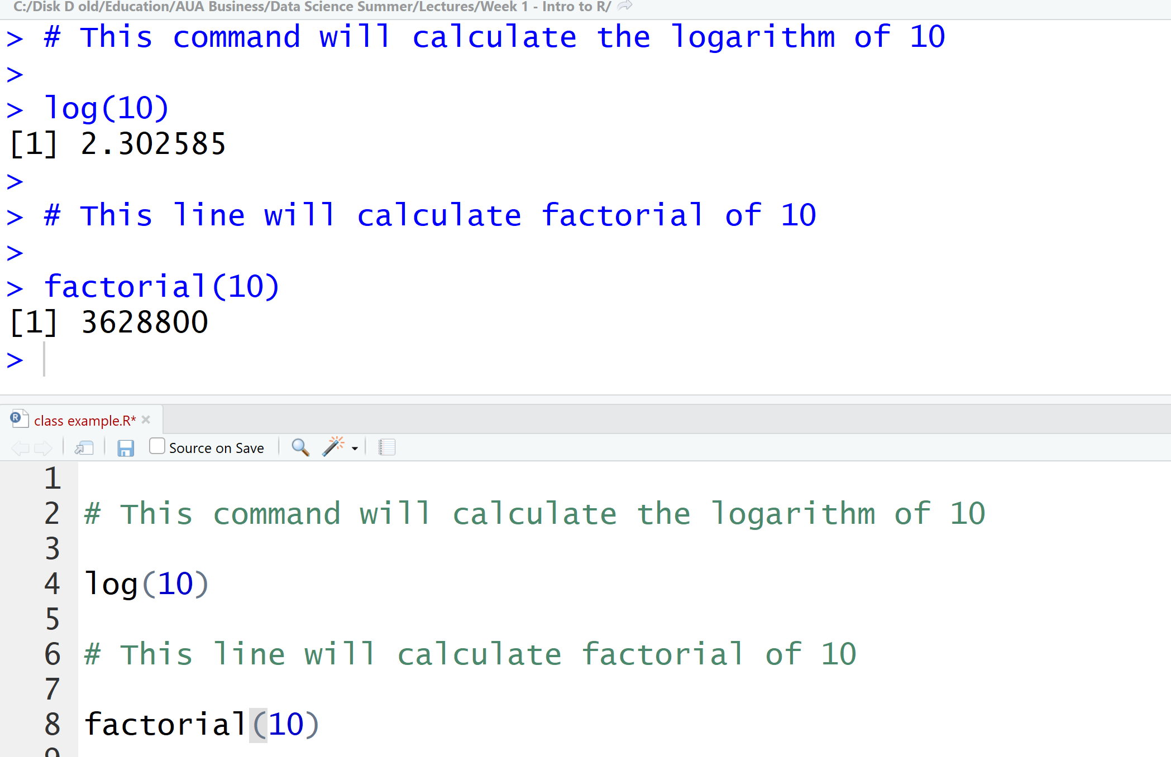
Intro to R
If you have a piece of text in your editor that is not a code (thus is not executable by R) then you need to comment it, add # before each line
When run this line of code will printed in console as a text
To comment large chunk of text, use ctrl+shift+c

Slide 15
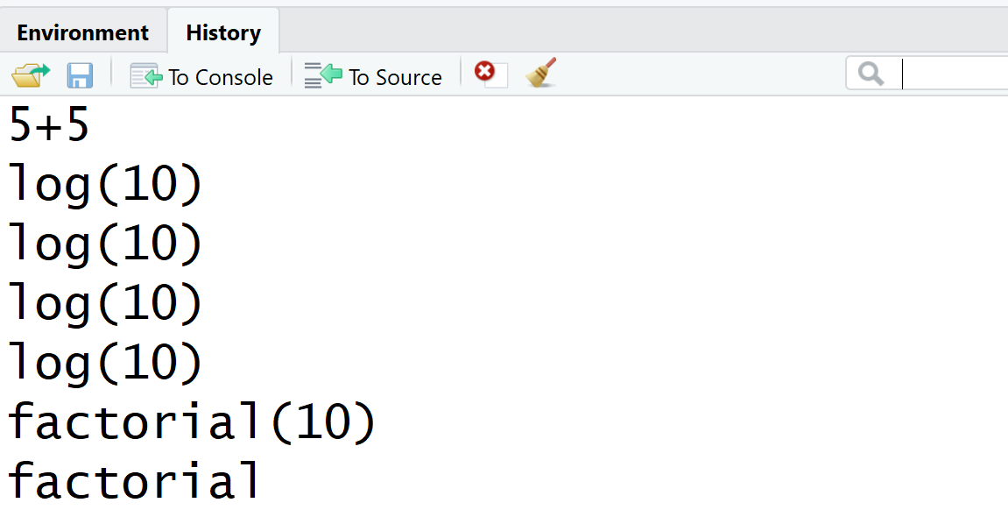
Intro to R
The environment window contains objects (data, values, functions) R has currently stored in its memory.
The history window shows all commands that were executed in the console.

Slide 16
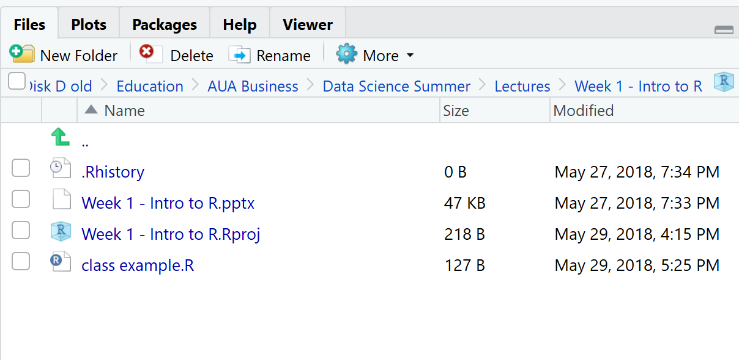
Intro to R
Bottom right: files, plots, packages, help, & viewer pane. Here you can open files, view plots, install and load packages, read man pages, and view markdown and other documents in the viewer tab.

Slide 17
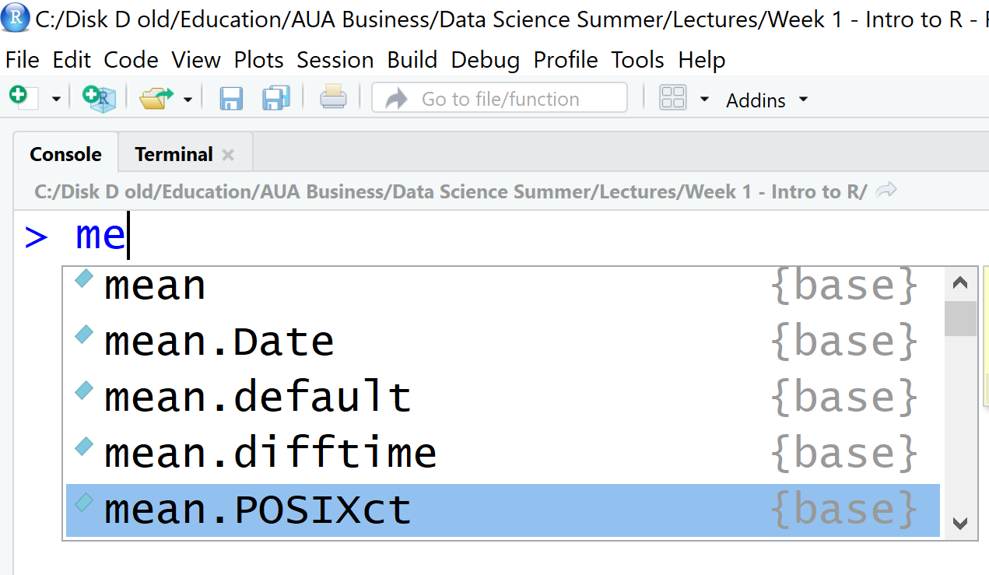
Intro to R
Some useful shortcuts:
type first few letters of the function/object then hit Tab to open dropdown menu with possible options

Slide 18
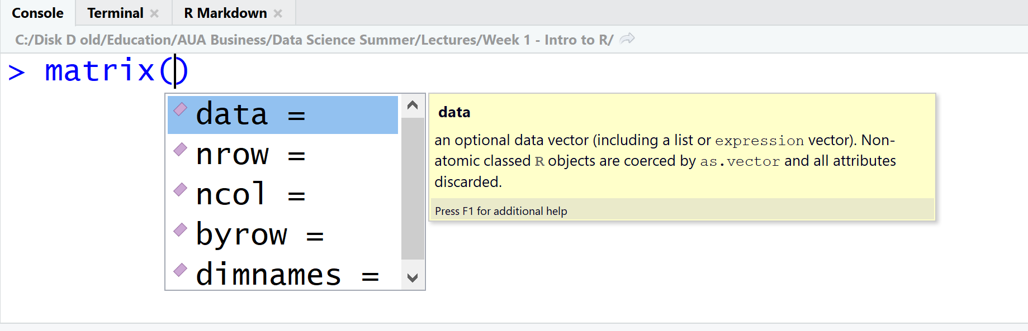
Intro to R: Function
to look at the function arguments, hit Tab
you need to name the arguments if they are not in the same order as defined in within the function
If the order is the same you can skip the names

Slide 19
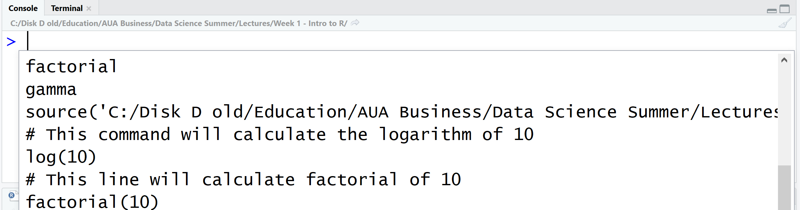
Intro to R
It's often the case that you want to re-execute commands that you previously entered. The RStudio console supports the ability to recall previous commands using the arrow keys:
Up — Recall previous command(s)
Down — Reverse of Up
You can even view a list of your recent commands by pressing Ctrl+Up on Windows or Command+Up on a Mac.

Slide 20
Intro to R
When you download R from the Comprehensive R Archive Network (CRAN), you get that ``base" R system
The base R system comes with basic functionality; implements the R language
One reason R is so useful is the large collection of packages that extend the basic functionality of R
R packages are developed and published by the larger R community

Slide 21
Install packages
Very often we are going to use functions that are not in base R, but instead are in external libraries (packages).
R library is a collection of functions/datasets developed by the community members for specific purposes.
You need to install library only once

Slide 22
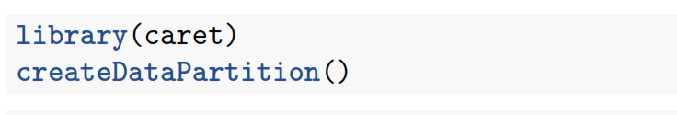
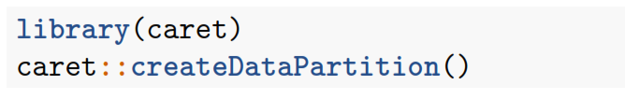
Install packages
To use the functions from the library, you need to call it first.
Need to do this only once per R session
If you restarted R, you need to call it again.
If you want to use specific function from the library without calling the whole library, use library::function()

Slide 23
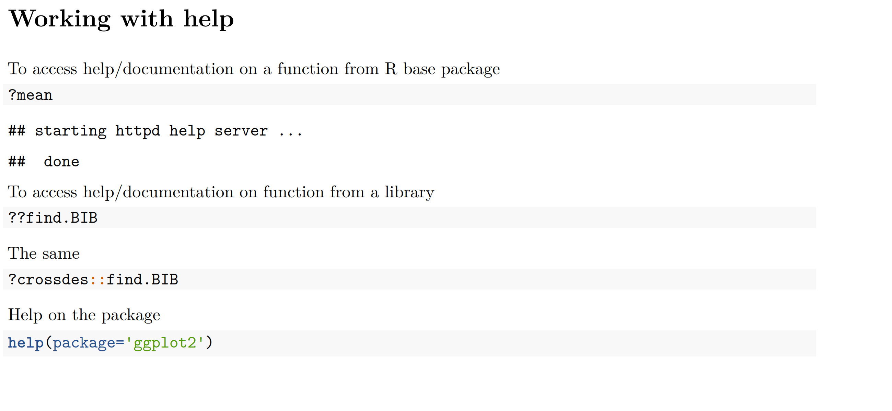
Intro to R

Slide 24
Intro to R
Each package on CRAN has its own webpage
This includes documentation
And sometimes includes vignettes
If you have a specific task to do, then look at R Task View
here are all the packages and R functionality described for the Time series analysis
https://cran.r-project.org/web/views/TimeSeries.html

Slide 25
R basic concepts

Slide 26
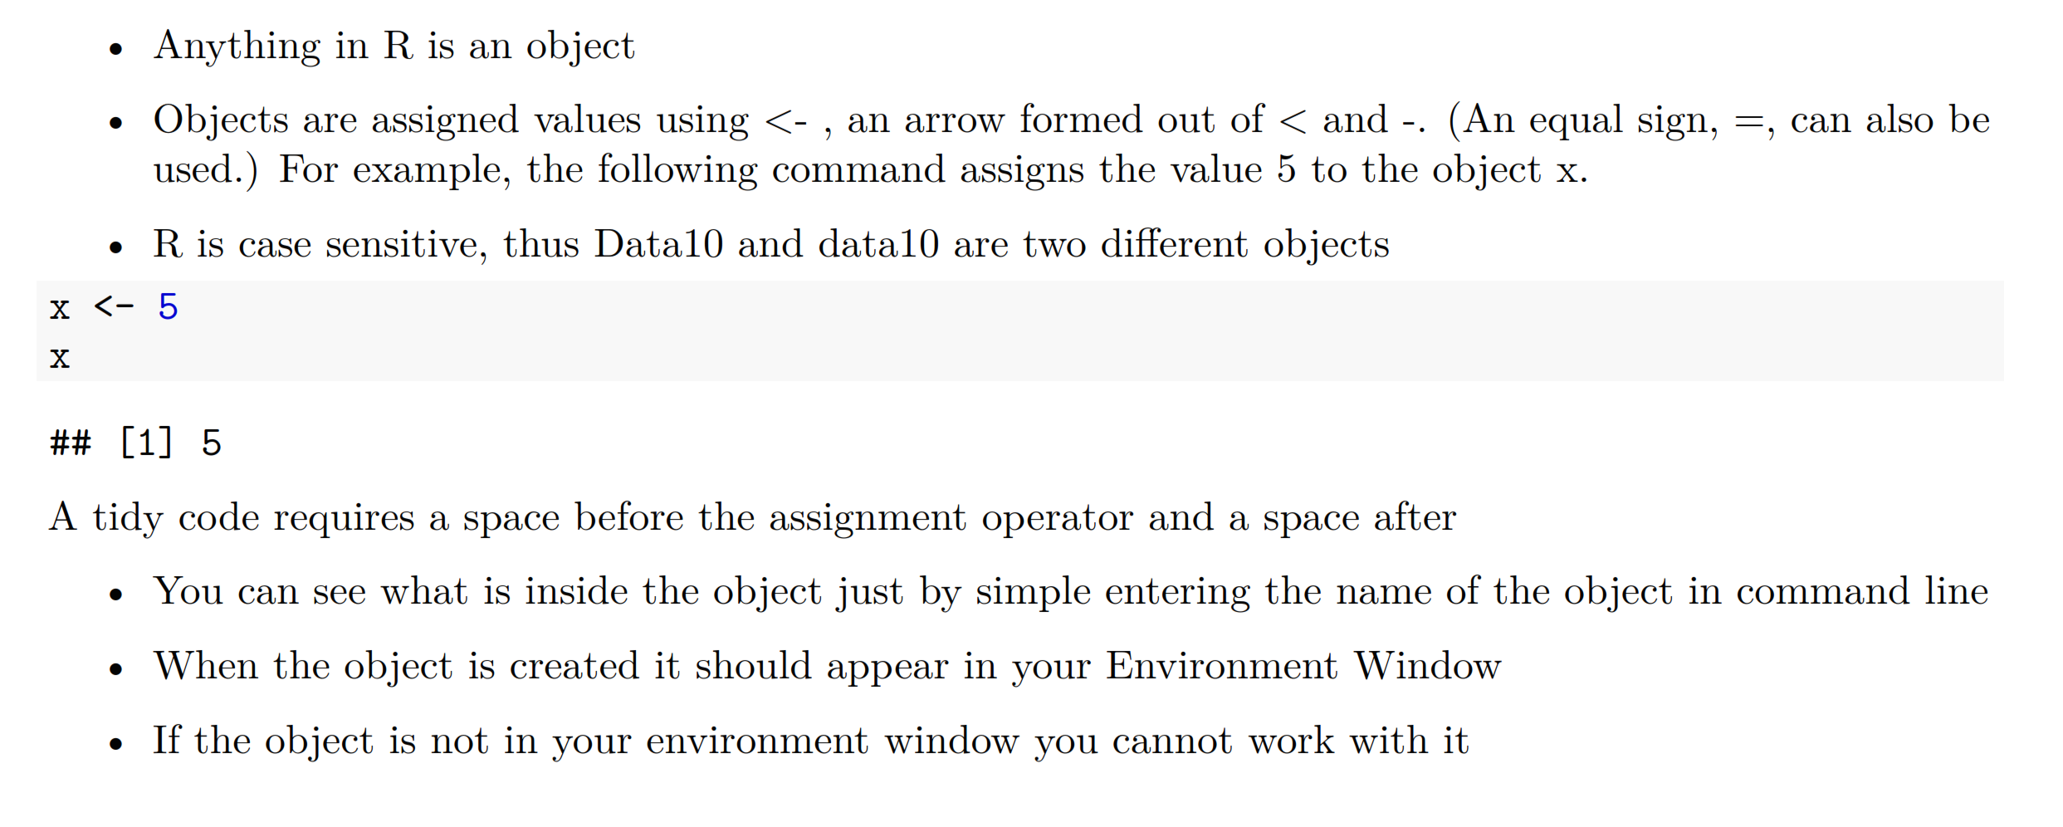
Intro to R: Data Structures

Slide 27
Variable
A basic concept in (statistical) programming is called a variable.
A variable allows you to store a value (e.g. 4) or an object (e.g. a function description) in R. You can then later use this variable's name to easily access the value or the object that is stored within this variable.
You can assign a value 4 to a variable my_var with the command
my_var <-4

Slide 28
Variable
You can do basic operations with variables
my_var <- 4
my_var1 <- 5
my_var + my_var1
[1] 9
Or you can create a new variable
var2<- my_var+my_var1
Notes:
Show that this works only for numeric variables

Slide 29
Data types in R
R works with numerous data types. Some of the most basic types to get started are:
Decimals values like 4.5 are called numerics.
Natural numbers like 4 are called integers. Integers are also numerics.
Boolean values (TRUE or FALSE) are called logical.
Text (or string) values are called characters.
Note how the quotation marks indicate that "some text" is a character.

Slide 30
Checking data type
Assign integer 42 to variable my_numeric
String "universe“ to my_character
FALSE to boolean my_logical
Now run
class() for each variable

Slide 31
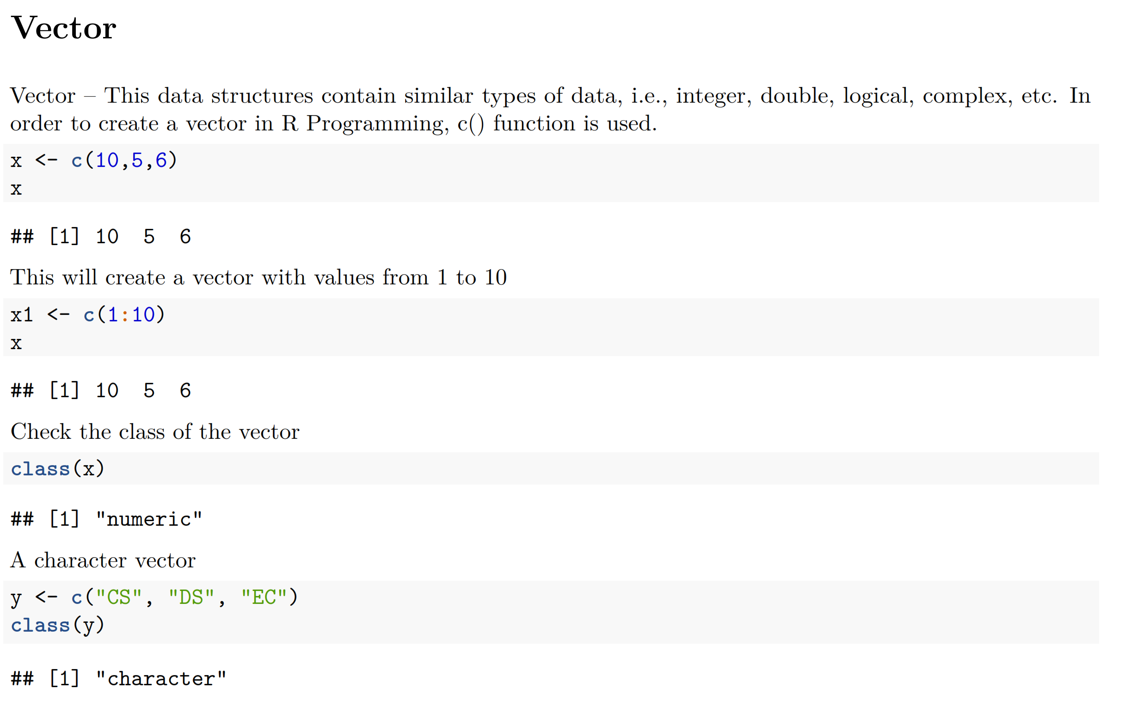
Intro to R: Data Structures

Slide 32
Working with vectors

Slide 33
Types of variables: Vectors
Vectors are one-dimension arrays that can hold numeric data, character data, or logical data. In other words, a vector is a simple tool to store data.
In R, you create a vector with the combine function c(). You place the vector elements separated by a comma between the parentheses. For example:
numeric_vector <- c(1, 2, 3)
character_vector <- c("a", "b", "c")
Notes:
create a Boolean vector

Slide 34
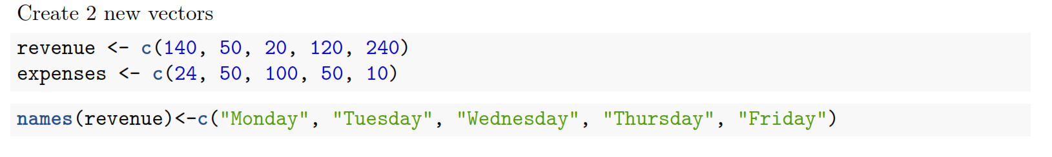
Naming a vector
Notes:
subset vector by name

Slide 35
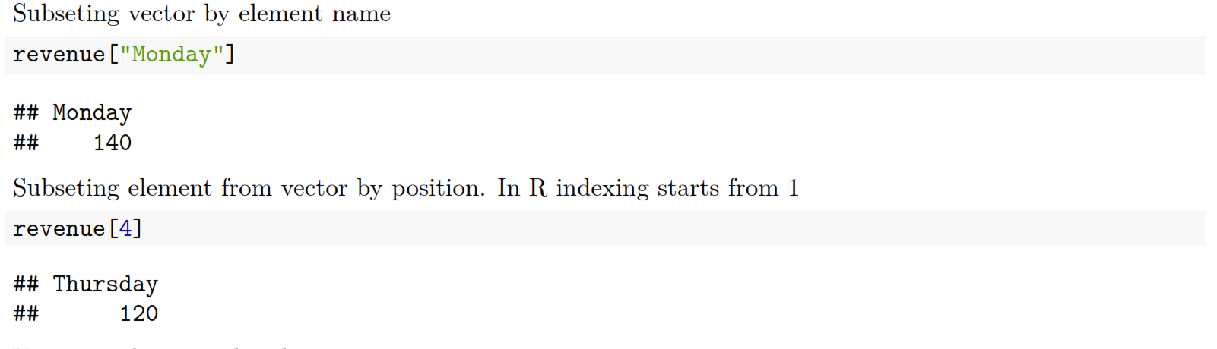
Subseting vectors

Slide 36
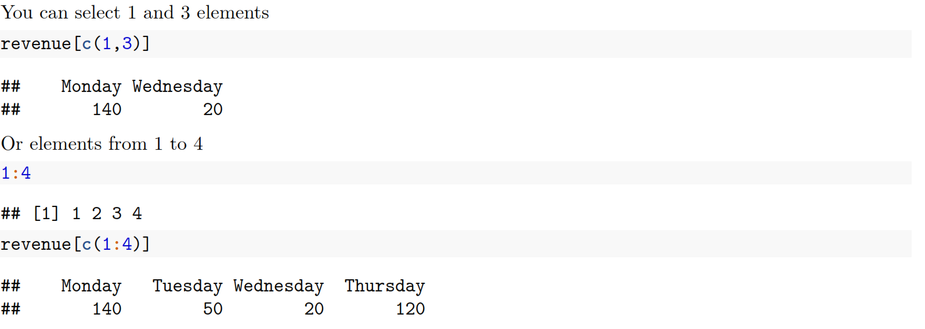
Subseting vectors

Slide 37
Operations with vectors
Arithmetic operations of vectors are performed member-by-member, i.e., memberwise.
For example, the following three statements are completely equivalent:
c(1, 2, 3) + c(4, 5, 6)
c(1 + 4, 2 + 5, 3 + 6)
c(5, 7, 9)
You can also do the calculations with variables that represent vectors:
a <- c(1, 2, 3)
b <- c(4, 5, 6)
c <- a + b

Slide 38
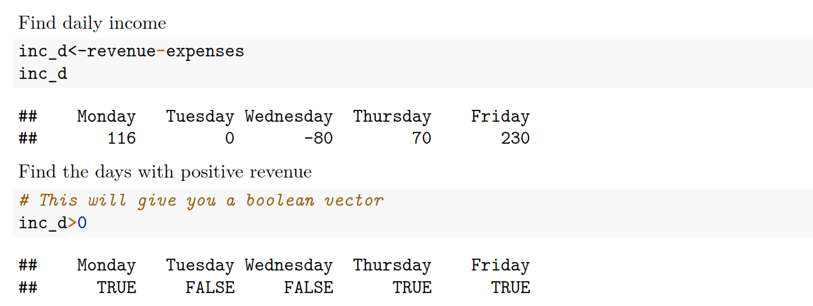
Working with vectors

Slide 39
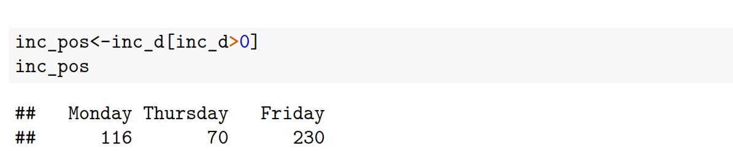
Subsetting on condition
Create a boolean vector with values TRUE when condition is met and FALSE when it does not
From the initial object chose only elements where the value of Boolean vector is true

Slide 40
Logical comparison operators
The (logical) comparison operators known to R are:
< for less than
> for greater than
<= for less than or equal to
>= for greater than or equal to
== for equal to each other
!= not equal to each other

Slide 41
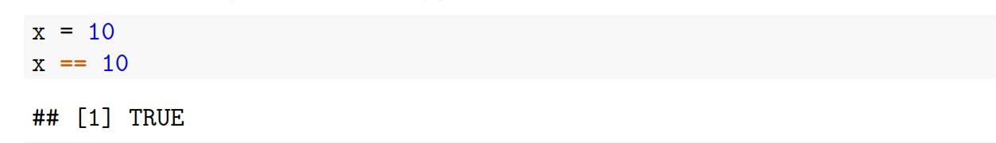
Intro to R
Difference between = and ==
= is an assignment operator
== is a comparison operato

Slide 42
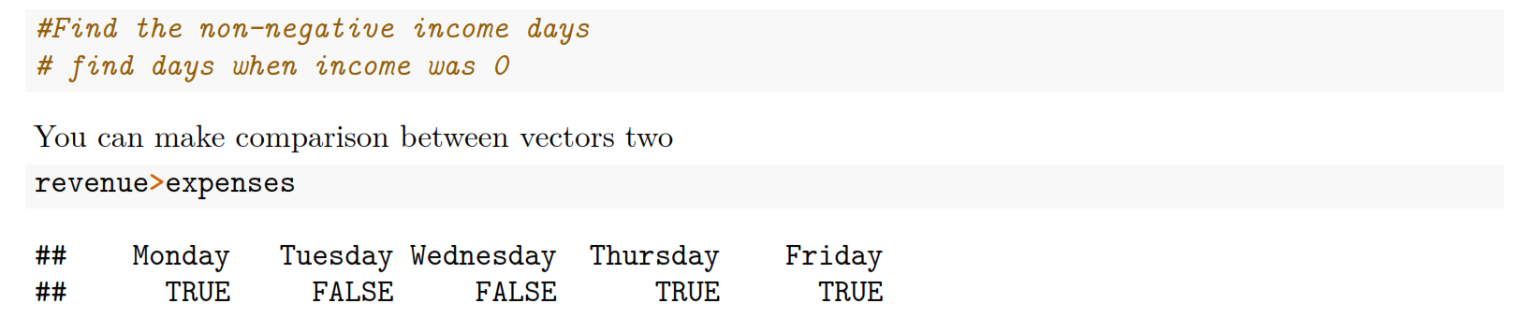
Working with vectors

Slide 43
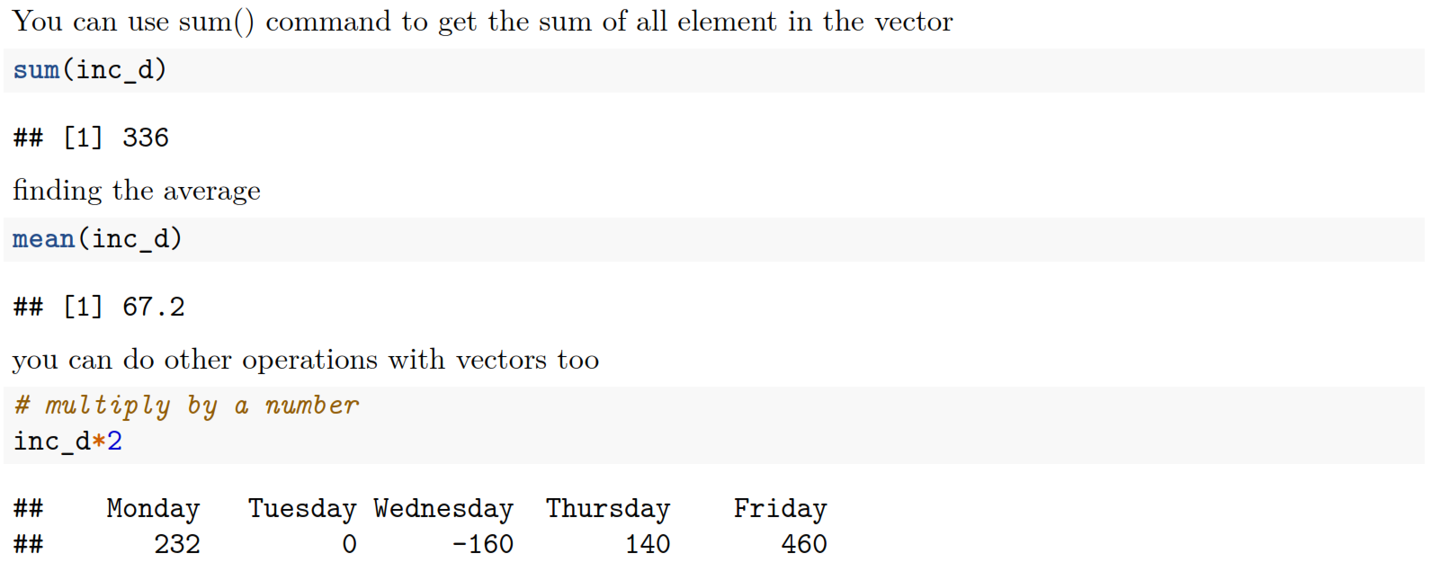
Working with vectors

Slide 44
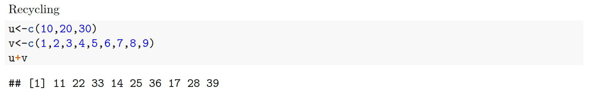
Working with vectors: Recycling
If two vectors are of unequal length, the shorter one will be recycled in order to match the longer vector. For example, the following vectors u and v have different lengths, and their sum is computed by recycling values of the shorter vector u.

Slide 45
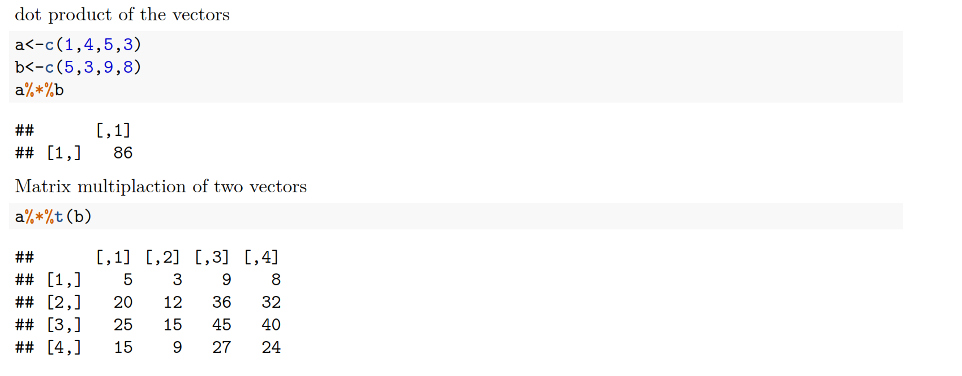
Working with vectors

Slide 46
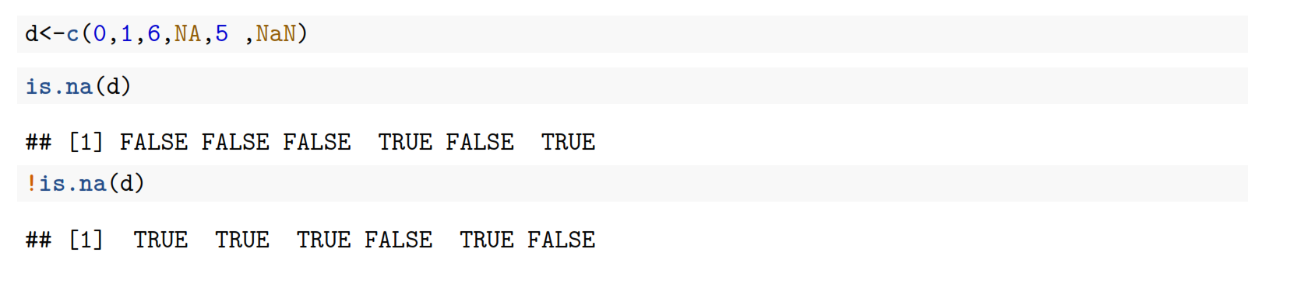
Missing values in R
In R, missing values are represented by the symbol NA (not available). Impossible values (e.g., dividing by zero) are represented by the symbol NaN (not a number).

Slide 47
Operations with Matrices

Slide 48
Matrix
In R, a matrix is a collection of elements of the same data type (numeric, character, or logical) arranged into a fixed number of rows and columns. Since you are only working with rows and columns, a matrix is called two-dimensional.
You can construct a matrix in R with the matrix() function. Consider the following example:

Slide 49
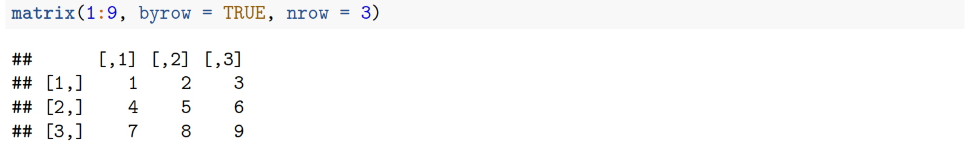
Matrix
In the matrix() function:
The first argument is the collection of elements that R will arrange into the rows and columns of the matrix. Here, we use 1:9 which is a shortcut for c(1, 2, 3, 4, 5, 6, 7, 8, 9).
The argument byrow indicates that the matrix is filled by the rows. If we want the matrix to be filled by the columns, we just place byrow = FALSE.
The third argument nrow indicates that the matrix should have three rows.

Slide 50
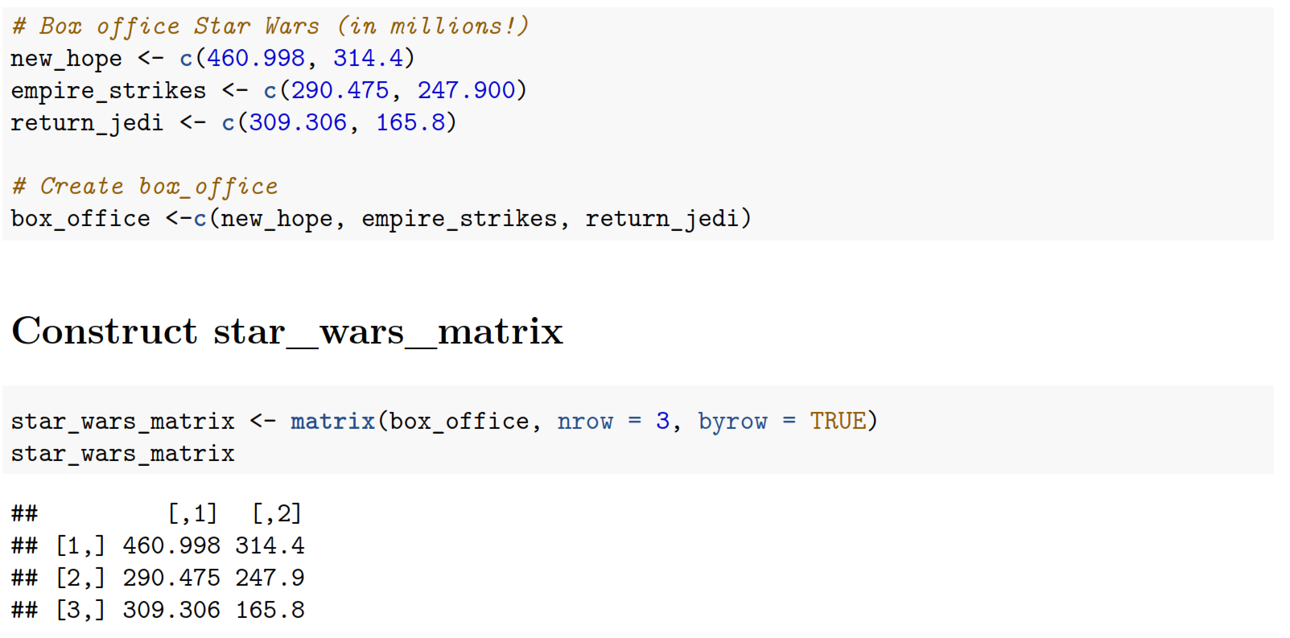
Star wars

Slide 51
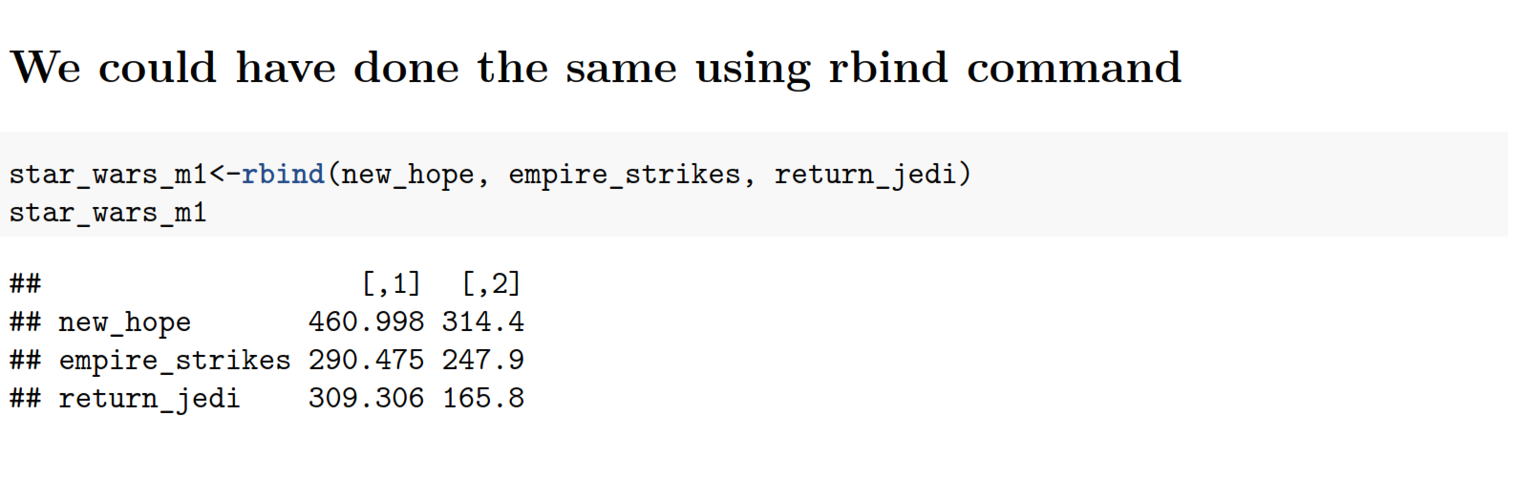
Operations with matrices

Slide 52
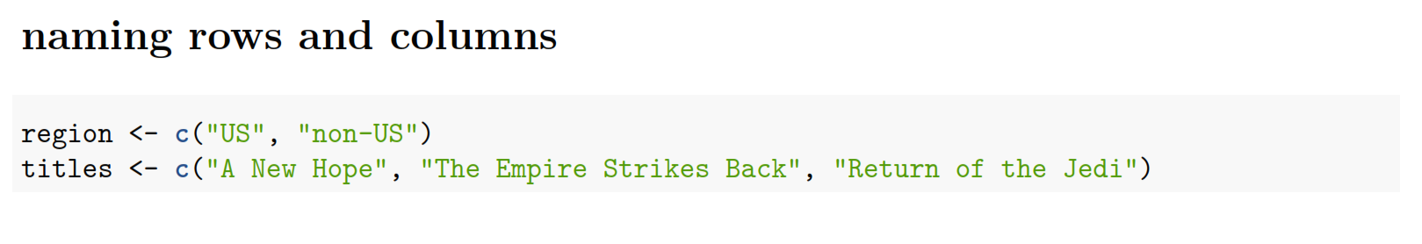
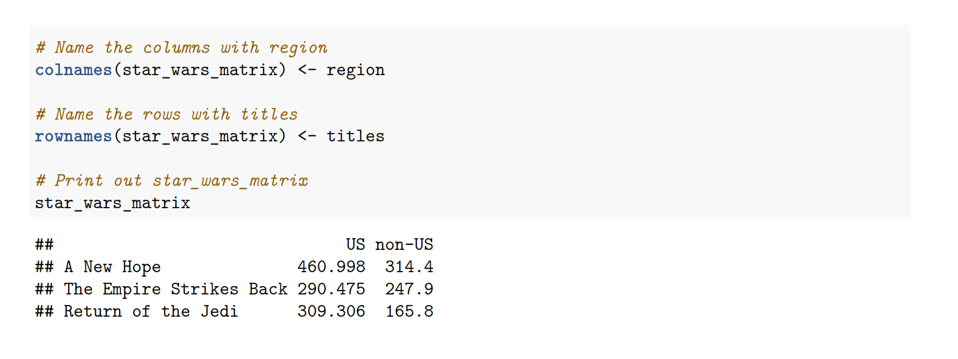
Naming rows and columns

Slide 53
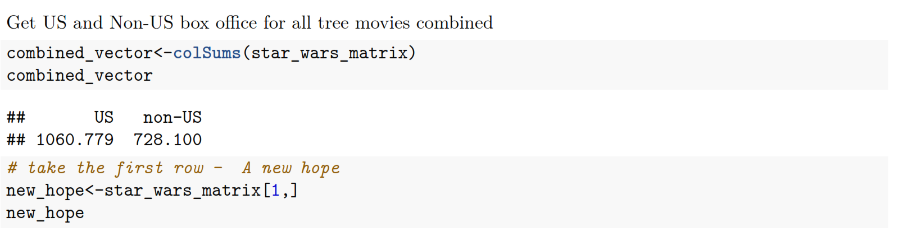
Operations with matrices

Slide 54
Subseting
Similar to vectors, you can use the square brackets [ ] to select one or multiple elements from a matrix. Whereas vectors have one dimension, matrices have two dimensions. You should therefore use a comma to separate that what to select from the rows from that what you want to select from the columns. For example:
my_matrix[1,2] selects the element at the first row and second column.
my_matrix[1:3,2:4] results in a matrix with the data on the rows 1, 2, 3 and columns 2, 3, 4.
If you want to select all elements of a row or a column, no number is needed before or after the comma, respectively:
my_matrix[,1] selects all elements of the first column.
my_matrix[1,] selects all elements of the first row.
Notes:
You can perform any arithmetic operation on a matrix

Slide 55
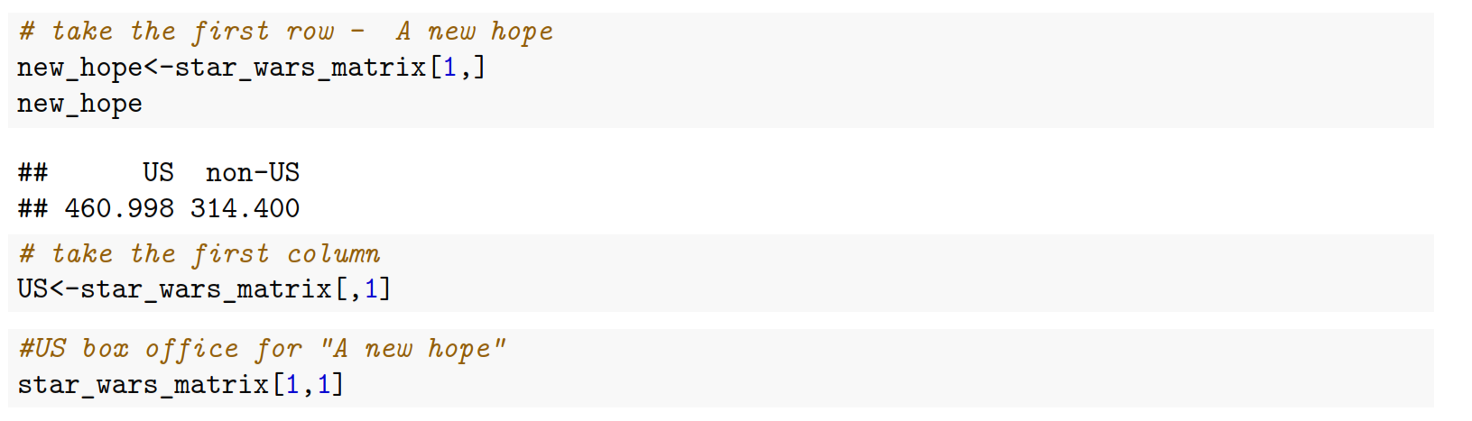
Subseting matrices

Slide 56
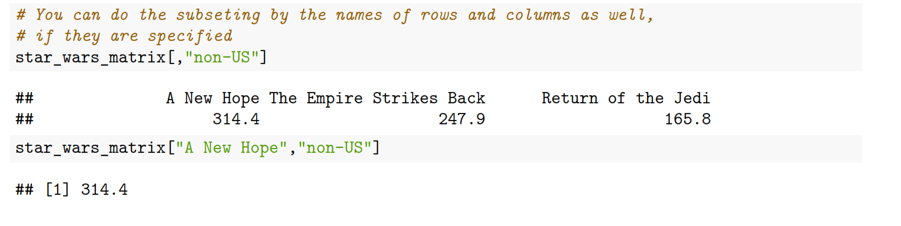
Subsetting matrices

Slide 57
Dataframes

Slide 58
Data frame
Data frame is a data set that contain different data types instead of only one. You can combine numeric and character variables into the same dataset
A data frame has the variables of a data set as columns and the observations as rows.
This will be a familiar concept for those coming from different statistical software packages such as SAS or SPSS.
Has the most use in Data analytics

Slide 59
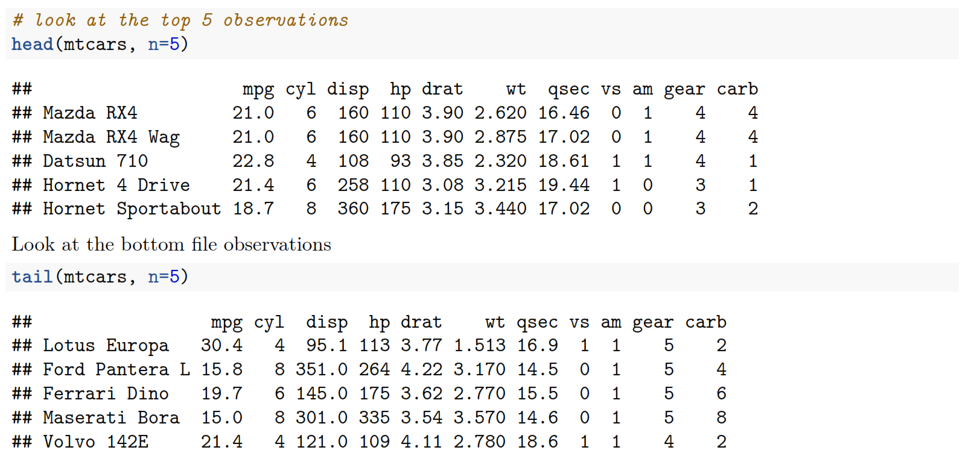
Data frames – head and tail
mtcars is an R built in dataset.
to work with it start with data(mtcars)
the dataframe will be visible as soon as you start working with it.

Slide 60
Structure of data frame
Another method that is often used to get a rapid overview of your data is the function str(). The function str() shows you the structure of your data set. For a data frame it tells you:
The total number of observations (e.g. 32 car types)
The total number of variables (e.g. 11 car features)
A full list of the variables names (e.g. mpg, cyl ... )
The data type of each variable (e.g. num)
The first observations

Slide 61
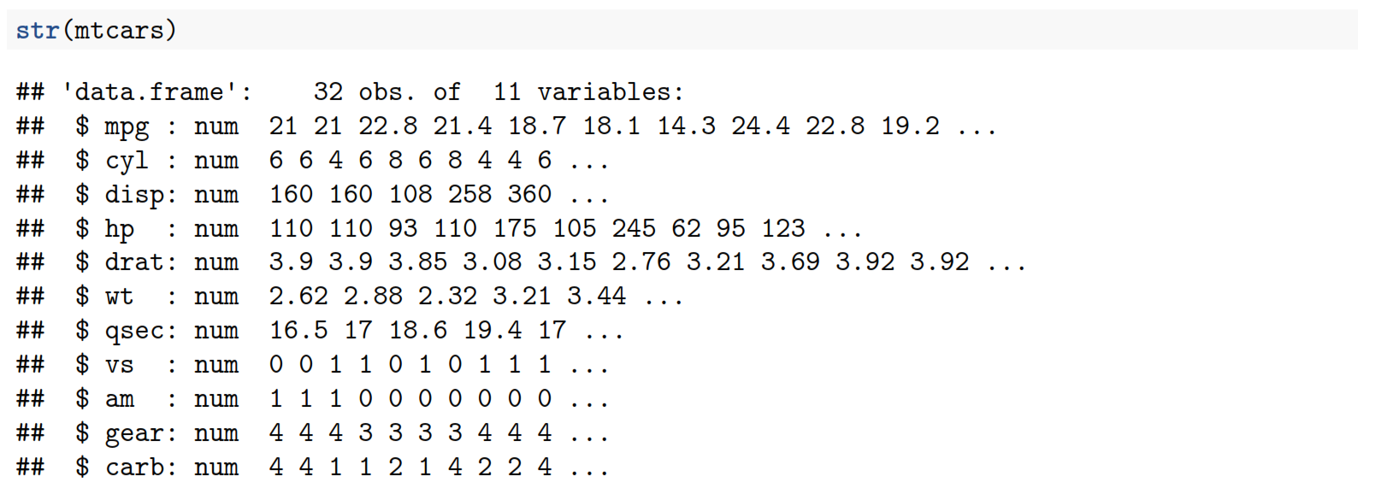
Data frames: structure

Slide 62
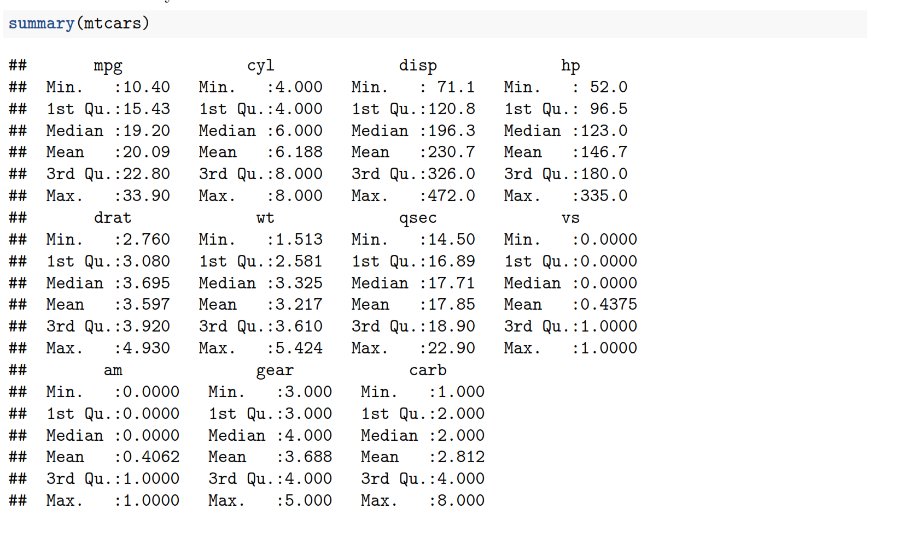
Data frames, summary

Slide 63
Subseting dataframes
Similar to vectors and matrices, you select elements from a data frame with the help of square brackets [ ]. By using a comma, you can indicate what to select from the rows and the columns respectively. For example:
my_df[1,2] selects the value at the first row and select element in my_df.
my_df[1:3,2:4] selects rows 1, 2, 3 and columns 2, 3, 4 in my_df.
Sometimes you want to select all elements of a row or column. For example, my_df[1,] selects all elements of the first row. Let us now apply this technique on

Slide 64
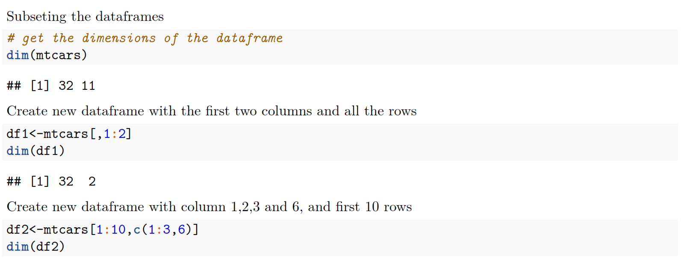
Subseting dataframes

Slide 65
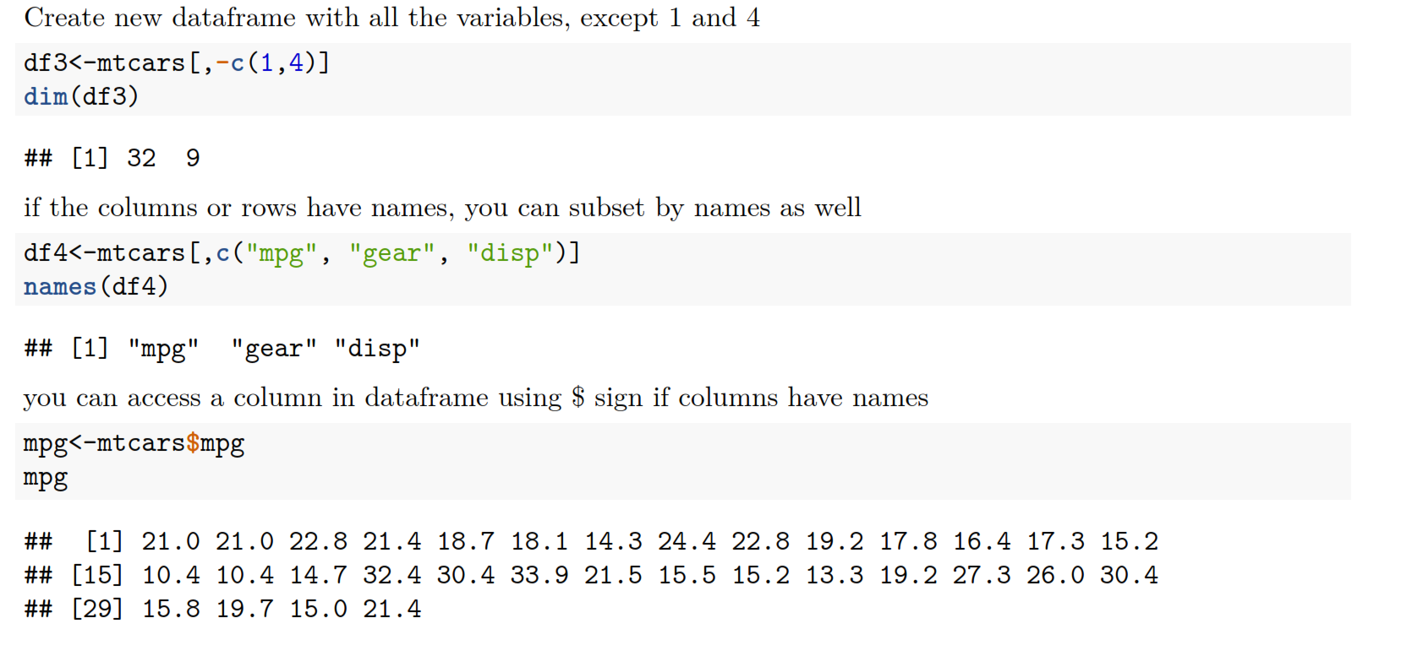
Sub setting data frames

Slide 66
Intro to R: Access vectors and objects from the list
The name of the data frame or list
The name of the variable or object from the list
Data$Age

Slide 67
Intro to R: Accessing subset of the data frame
Extract variables (columns) from 2 to 5
Extract cases (rows) from 1 to 500
Data[1:500, 2:5]

Slide 68
Subseting data: dataframes
Will return the value on first row and 4th column
dataframe[1 ,4 ]
Will return the value on first 10 rows and columns 4,5,6
dataframe[1:10 ,4:6 ]

Slide 69
Subseting data: dataframes
Will return the first 10 rows and all columns
dataframe[1:10 , ]
If you want to select all elements for the given index, just leave the placeholder empty.
What will this command return ?
dataframe[,c(2,4:6) ]

Slide 70
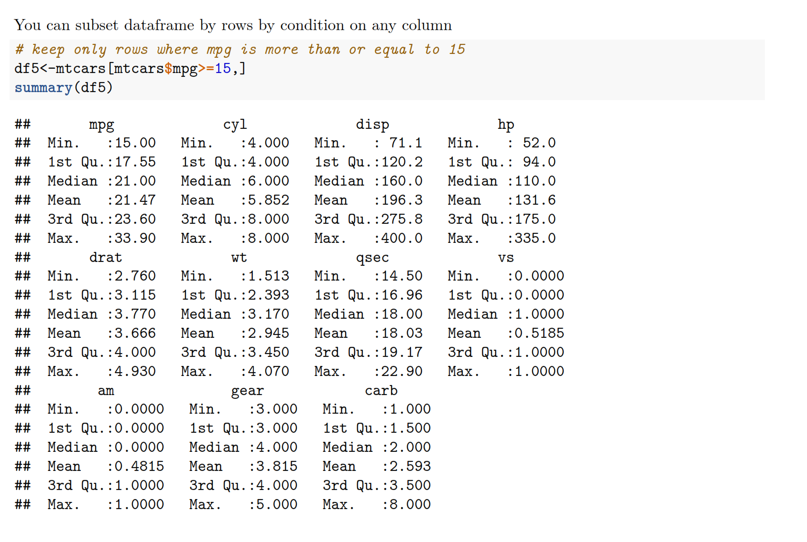
Sub setting data frames

Slide 71
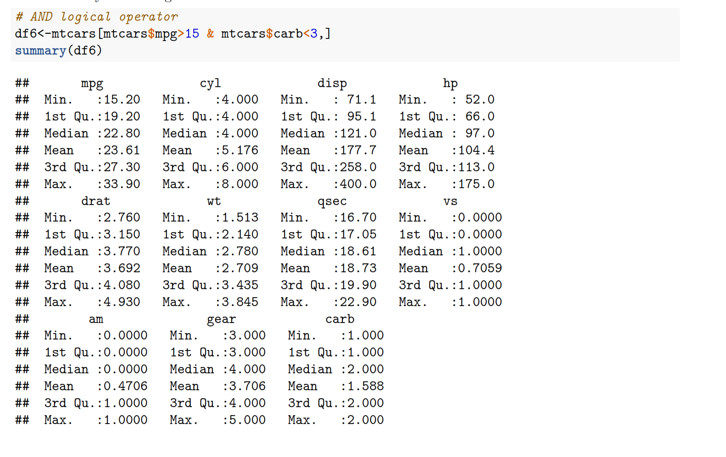
Sub setting data frames
Can subset by using more than 1 condition

Slide 72
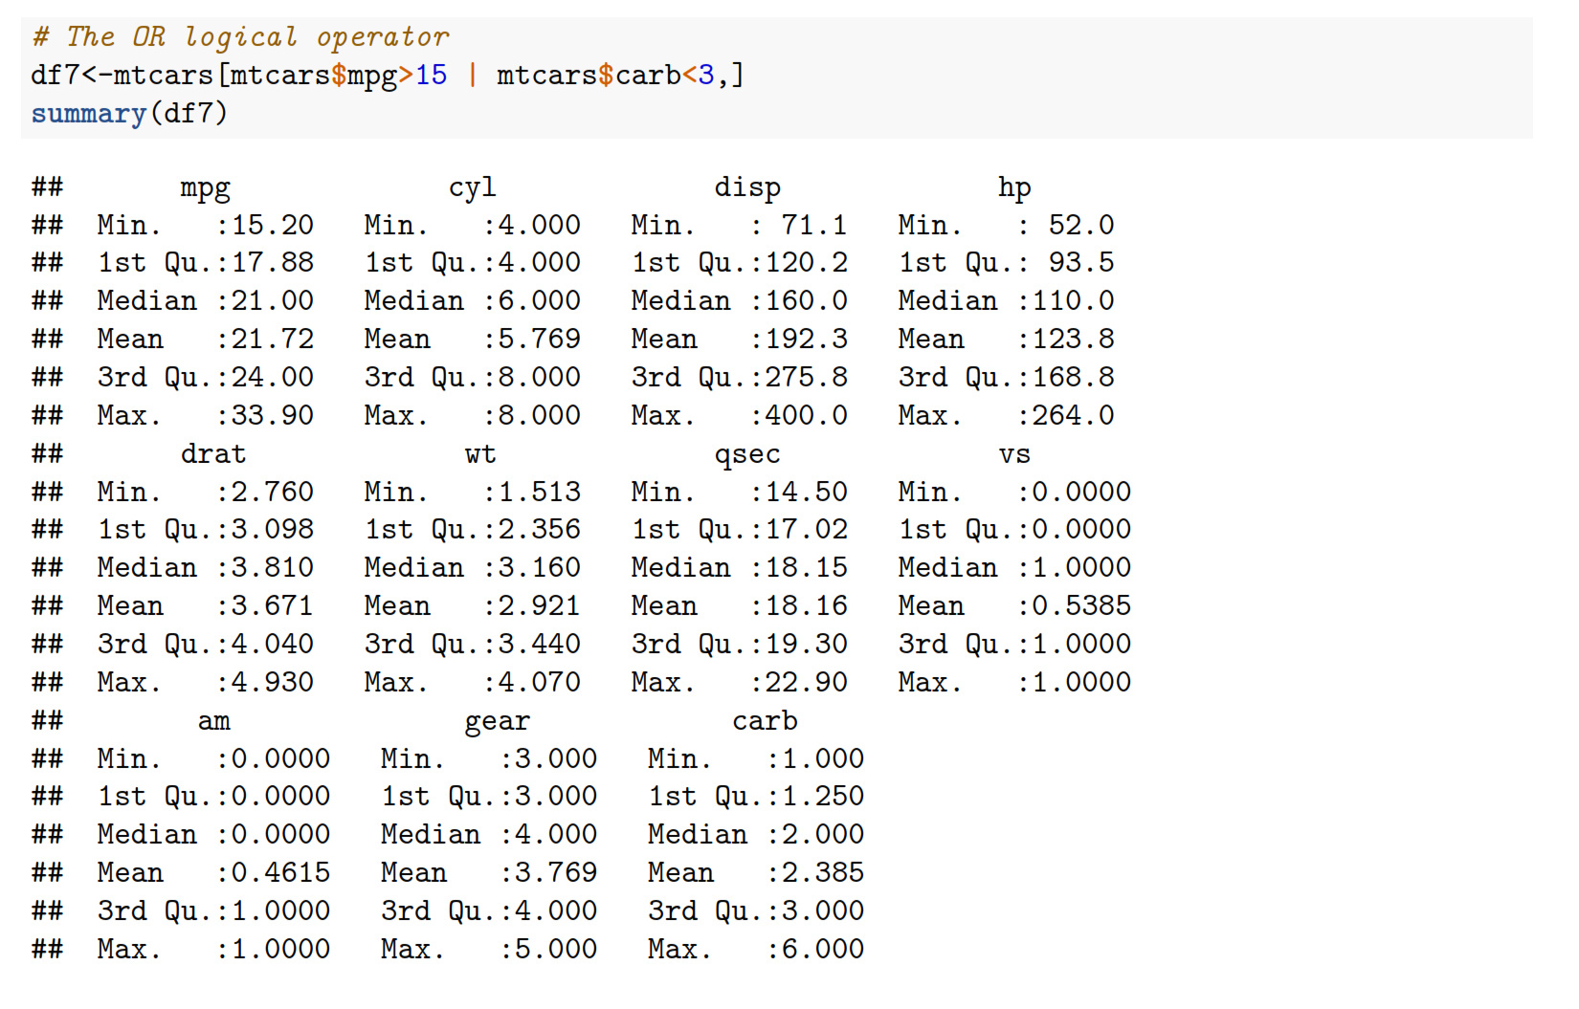
Sub setting data frames

Slide 73
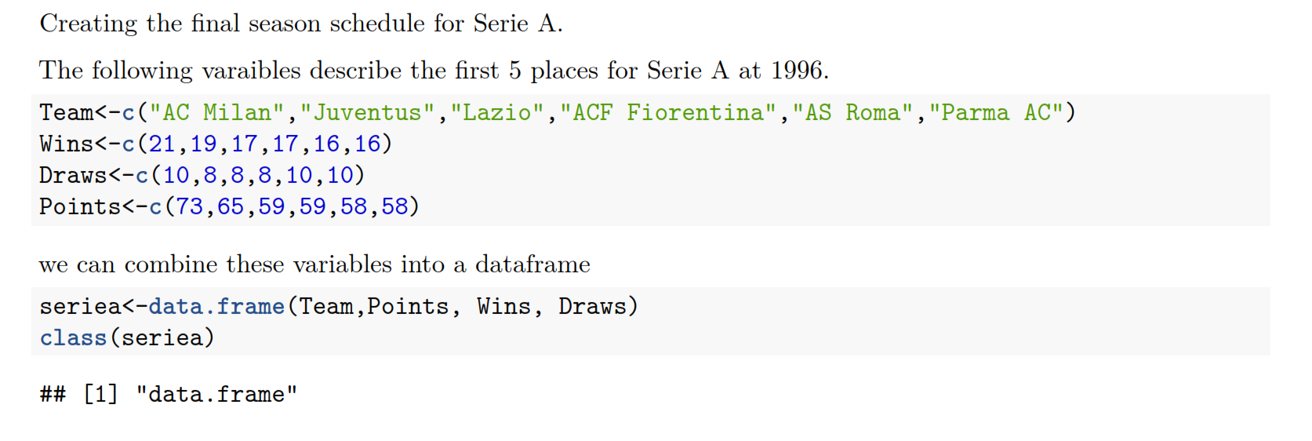
Data Frames: creating new data frame

Slide 74
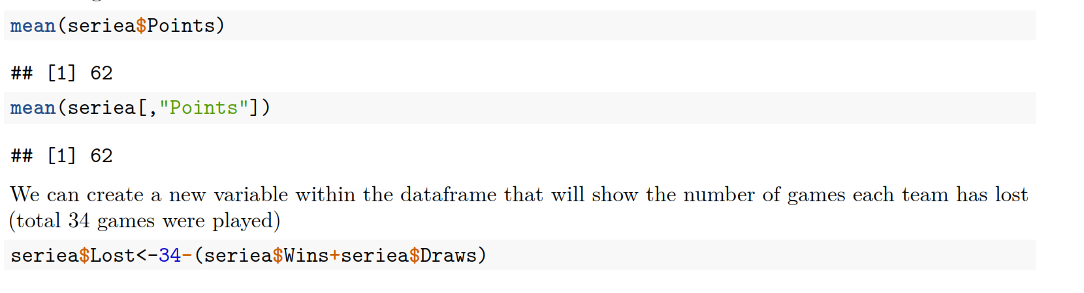
Operations with dataframes

Slide 75

Intro to R: Data Structures
A data frame is the most common way of storing data in R, and if used systematically makes data analysis easier.
Under the hood, a data frame is a list of equal-length vectors that can also have different types
Row numbers

Slide 76

Intro to R: Data Structures

Slide 77

Intro to R: Data Structures

Slide 78

Intro to R: Data Structures
Two columns (vectors) in the df have different types

Slide 79
List

Slide 80
List
So far we have looked at the following objects
Vectors (one dimensional array): can hold numeric, character or logical values. The elements in a vector all have the same data type.
Matrices (two dimensional array): can hold numeric, character or logical values. The elements in a matrix all have the same data type.
Data frames (two-dimensional objects): can hold numeric, character or logical values. Within a column all elements have the same data type, but different columns can be of different data type.

Slide 81
List
A list in R allows you to gather a variety of objects under one name (that is, the name of the list) in an ordered way. These objects can be matrices, vectors, data frames, even other lists, etc. It is not even required that these objects are related to each other in any way.
You could say that a list is some kind super data type: you can store practically any piece of information in it!

Slide 82
List
Let us create our first list! To construct a list you use the function list():
my_list <- list(comp1, comp2 ...)
The arguments to the list function are the list components. Remember, these components can be matrices, vectors, other lists, ...

Slide 83

List

Slide 84
List
You can see that elements in the list does not have names, which can be confusing. We need to name elements in the list
my_list <- list(name1 = your_comp1, name2 = your_comp2)
This creates a list with components that are named name1, name2, and so on. If you want to name your lists after you've created them, you can use the names()function as you did with vectors. The following commands are fully equivalent to the assignment above:
my_list <- list(your_comp1, your_comp2) names(my_list) <- c("name1", "name2")

Slide 85

List

Slide 86

List: The shining

Slide 87

Sub setting the list

Slide 88

Sub setting the list

Slide 89

Lists

Slide 90
Data Types again

Slide 91

Intro to R: Data types

Slide 92

Intro to R: Data types
Coercion of numeric and logical values will result as numeric

Slide 93

Intro to R: Data types
String literals or string values are stored as Character objects in
R.

Slide 94

Intro to R: Data Structures

Slide 95

Intro to R: Data types
Factors

Slide 96

Intro to R: Data types
You can relevel the factor variable by changing the reference value

Slide 97
Functions

Slide 98
Functions
In programming, you use functions to incorporate sets of instructions that you want to use repeatedly or that, because of their complexity, are better self-contained in a sub program and called when needed.
A function is a piece of code written to carry out a specified task; it can or can not accept arguments or parameters and it can or can not return one or more values.
In fact, there are several possible formal definitions of ‘function’ spanning from mathematics to computer science.
Generically, its arguments constitute the input and return values as output.

Slide 99
Functions
Functions have named arguments which potentially have default values.
The formal arguments are the arguments included in the function definition.
The formals function returns a list of all the formal arguments of a function.
Not every function call in R makes use of all the formal arguments.
Function arguments can be missing or might have default values

Slide 100

Functions
functions runif generate random numbers from continuous uniform distribution
Arguments are:
n, number of observations, with no default so needs to be specified
min, the minimum
max, the maximum

Slide 101


Functions
Matching arguments:
R functions arguments can be matched positionally or by name. So the following calls to runif are all equivalent (you can mix them as well).
Matching by name
Matching by position

Slide 102

Functions
matched by position, this will give you an error

Slide 103

Functions
If the argument has a default value and is not defined then the default value is used.
Generated 10 numbers with min=0, max=1

Slide 104

Functions
You can look at the arguments of the function and their description by hitting tab inside the brackets

Slide 105
Reading data

Slide 106


CSV files
csv (comma separated values)- the most common file format we will use
Use read.csv to get csv file into your R environment
Look at the top right of R studio window, you need to see census object.
If you don’t see it there you cant work with it

Slide 107

Reading r data file
R data files are saved with extension .rda
Check to see if you have it in your project directory
rm(list=ls()) will clean you environment
To load rda file to environment, use load(‘filename.rda’)
  Pay attention: you are not assigning rda file to an object, just loading it

Slide 108

Census R: factor and characters

Slide 109

Census R: factor and characters
Variable happy is a categorical variable where
1-Very happy
2-Pretty happy
3- Not to happy
We convert to factor specifying levels and labels

Slide 110

Census R: factor and characters
type of the variable: factor

Slide 111

Census R: factor and characters
function table will count frequencies of each value in the variable

Slide 112

Census R: factor and characters
create another dataframe with with only region 8
You can see that there are no very happy people here ☹
So the count value for Very Happy is 0

Slide 113

Census R: factor and characters
Now change the type of variable happy to character
Subset it again
count the frequencies
Very happy is not even in the table
One reason why you need a factor() variable

Slide 114
R markdown

Slide 115

R markdown
R Markdown documents are fully reproducible
It allows to combine text and code together in one report
You can use multiple languages within markdown file (R, python, SQL)
R Markdown supports dozens of static and dynamic output formats including HTML, PDF, MS Word, Beamer, HTML5 slides, etc
R markdown is run in its own environment

Slide 116

R markdown
The workflow

Slide 117

R markdown
To open new markdown file

Slide 118

R markdown
The document below is a template R Markdown document. It includes the most familiar parts of an R Markdown document:
A YAML header that contains some metadata (1)
Narrative text written in Markdown (2)
R code chunks surrounded by ```{r} and ```; a syntax that comes from the knitr package (3)
1
2
3

Slide 119

Now you can knit your report to different formats
For pdf files, you need to have MikTex installed (it is going to take a lot of time)

Slide 120
Common errors

Slide 121
Common errors
Check for spelling errors
Check for typos
Check for missed comma or quotation

Slide 122

Errors
When reading the data
typo/spelling error – not censas but census
if the name is right, than the file is not in your working directory

Slide 123

errors
Could not find the function
  Typo, misspelling
  Forgot to call library that the given function belongs to
To use function qplot() from ggplot2 library, first call library(ggplot2).
Remember need to call library only once per R session

Slide 124


errors
Subseting the mtcars dataframe where the variable drot>3
No error is returned, however the resulting dataframe has 0 rows
Why ?

Slide 125

errors
Subseting the dataframe census by taking all the rows and columns 20 to 25
census has only 23 columns

Slide 126

errors
While trying to install the library….
typo….

Slide 127

errors
Plus sign in the console and nothing is happening
you forgot to close the parenthesis
hit ESC while in console and fix the code

Slide 128

errors
Some part of the code is in green,
error indicators

Slide 129
errors
The strings need to be in quotation marks.
Try to find the problem here

